Slide 1
BASIC JAPANESE LANGUAGE 1
GLT1031 (WEEK 7)

Slide 2
PREVIOUS LESSON
About topic : | To talk briefly about your family
Grammar : | A. Mention how many family member do you have B. Who are they (particle と) Information about your family member (name, age, occupation, nationality) Mention where they lives

Slide 3
復習しましょう・ふくしゅうしましょう
G1
かぞくはなんにんですか
G2
だれですか
G3
＿＿＿のなまえはなんですか
G4
かぞくはどこにすんでいますか

Slide 4


5
わたしはすしがすきです
I like sushi

Slide 5
CONTENTS OF THIS LESSON
About topic : | To talk about your favorite food & breakfast
Grammar : | Talk about likes & dislikes (general) Talk about actions such as what one eats or drinks Say how frequently the action is done

Slide 6
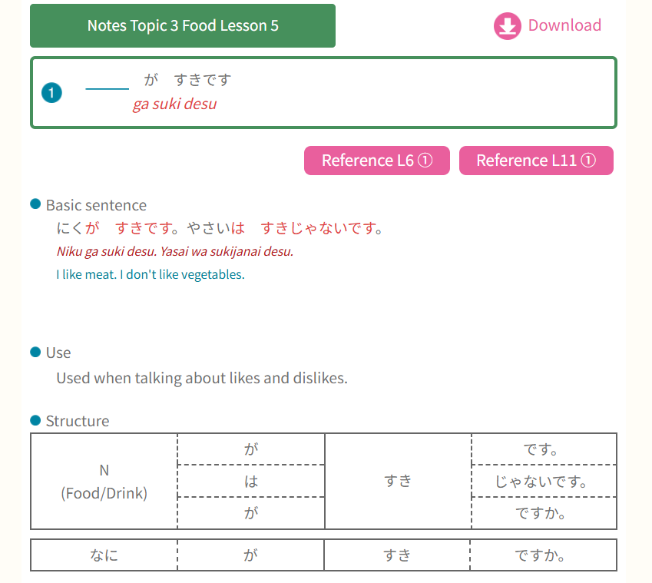
GRAMMAR PART
① Talk about likes & dislikes (general)
すきです (adj) – like

Slide 7
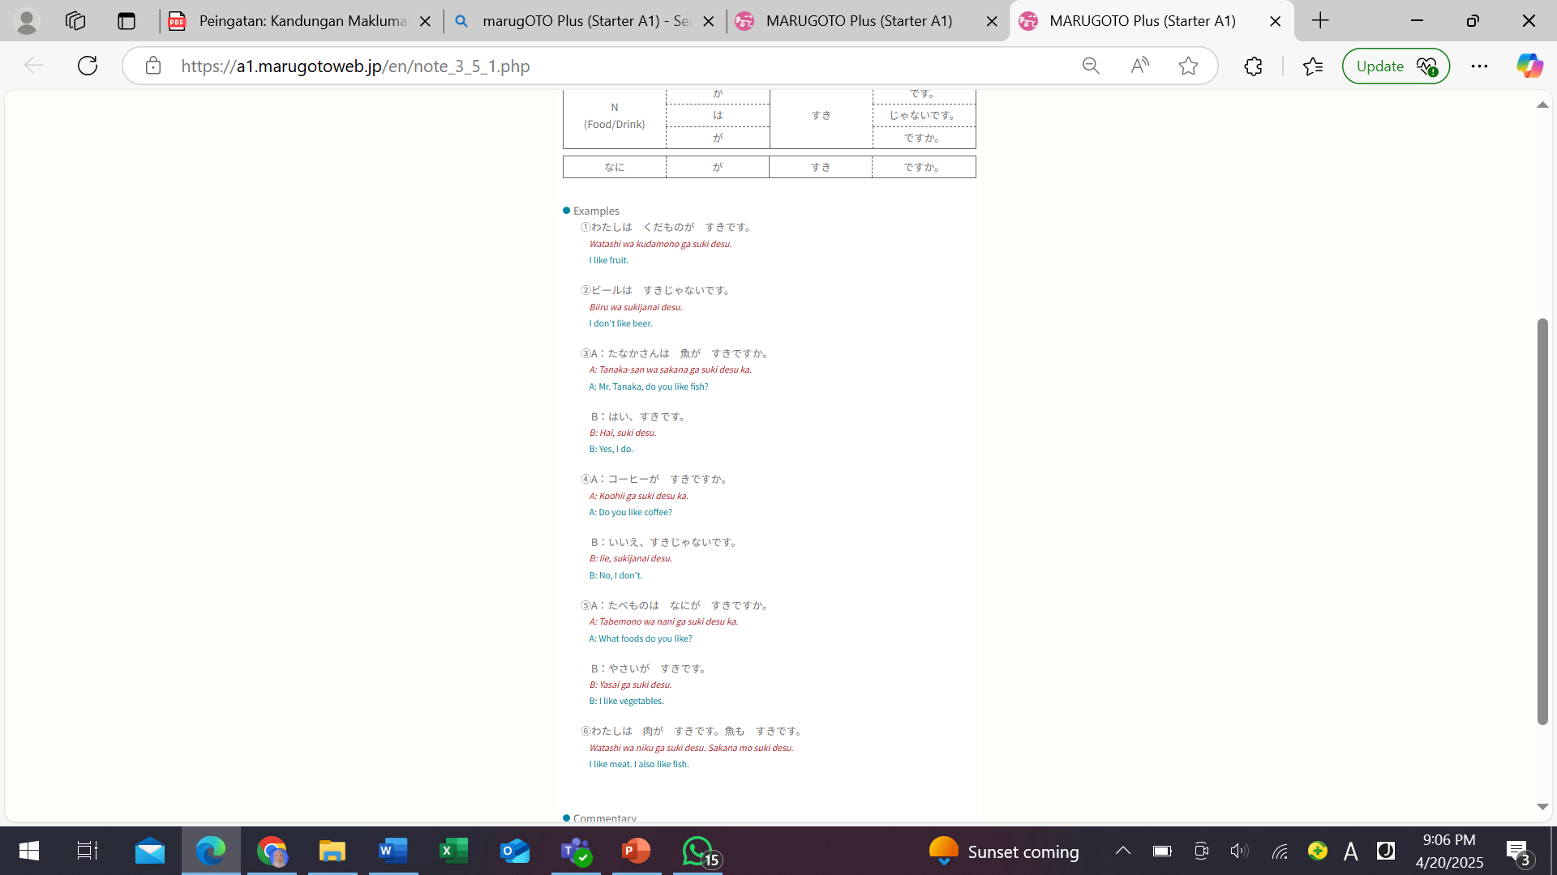

Slide 8
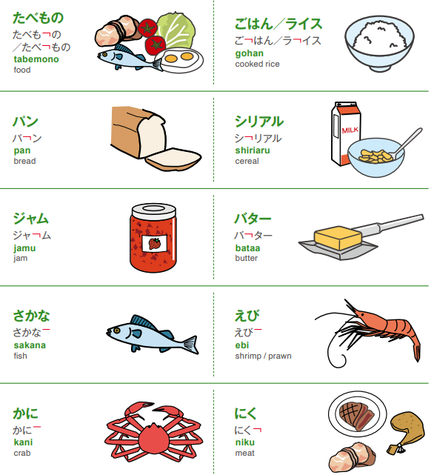
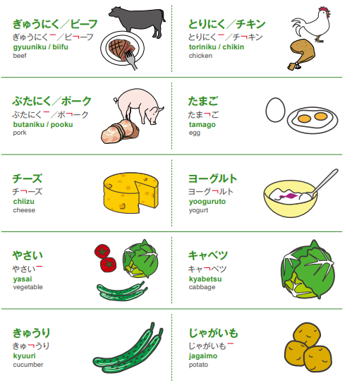
MarugotoStarterWordbook_EN

Slide 9
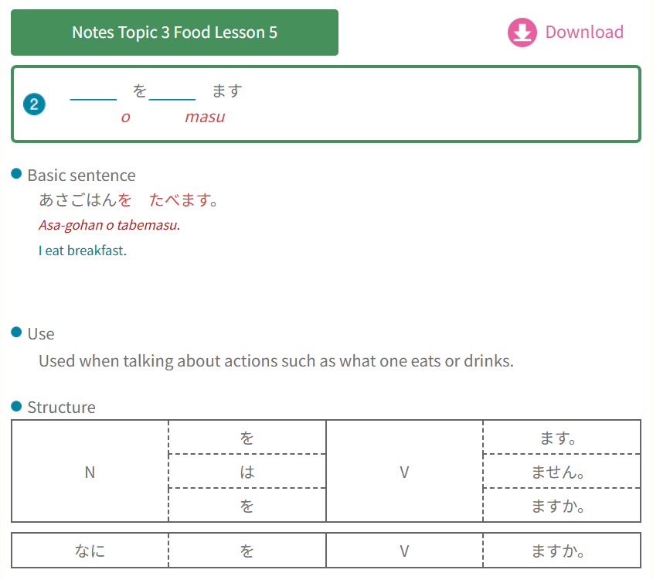
GRAMMAR PART
② Talk about actions such as what
one eats or drinks
S は O を V ます
ます used with verb (+ form)
To eat – tabe(masu)
To drink – nomi(masu)

Slide 10
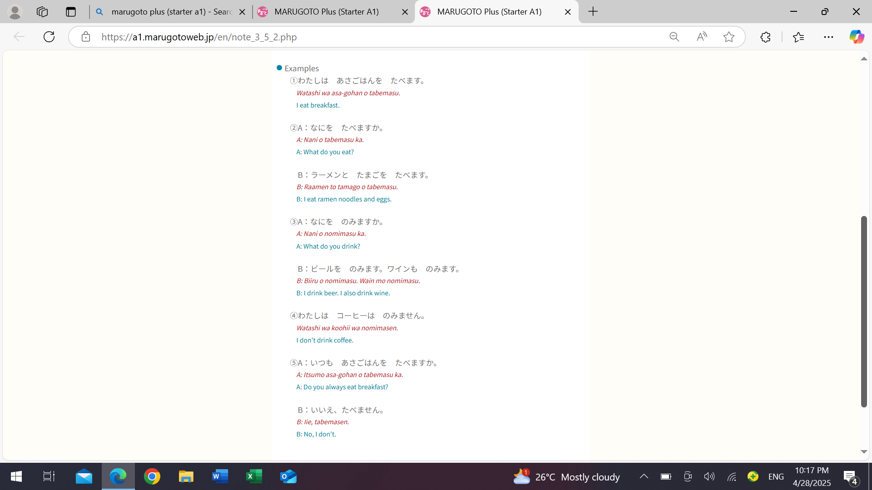

Slide 11
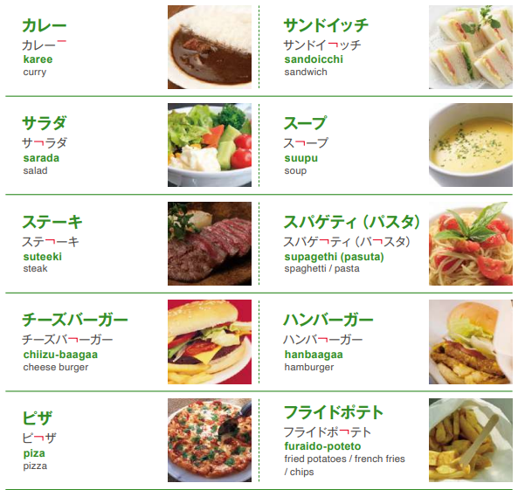
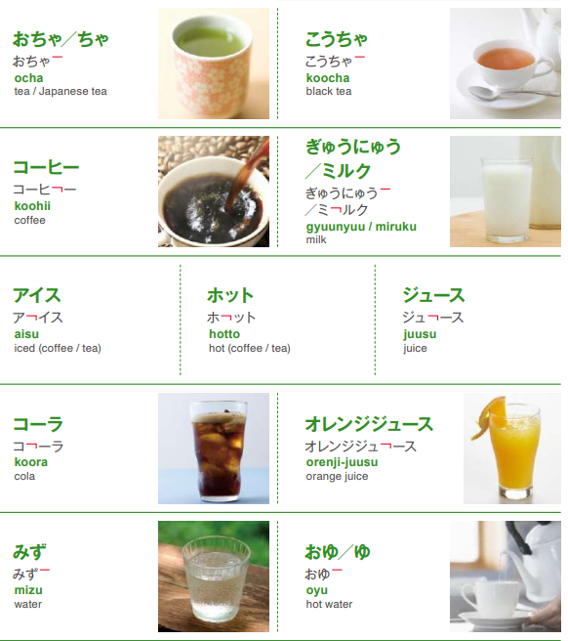
MarugotoStarterWordbook_EN

Slide 12
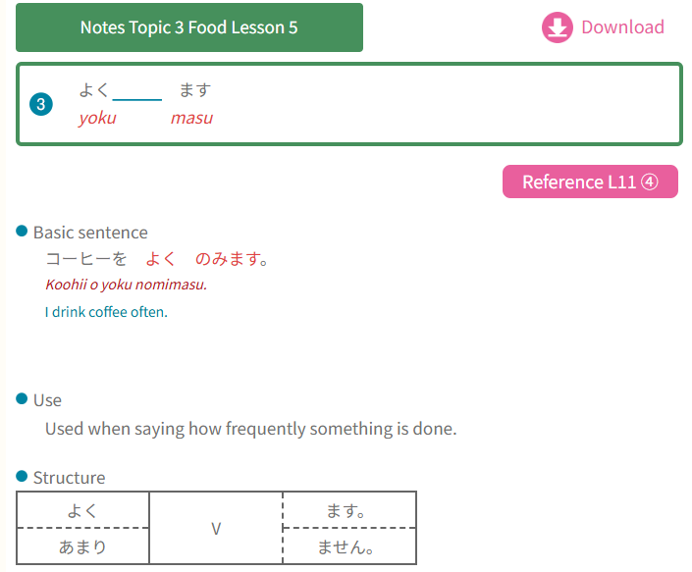
GRAMMAR PART
③ Say how frequently the action is done
よく + verb (+) Yoku | Often
ときどき + verb (+) tokidoki | sometime
あまり + verb (-) Amari | Not much
ぜんぜん + verb (-) Zenzen | Not at all

Slide 13
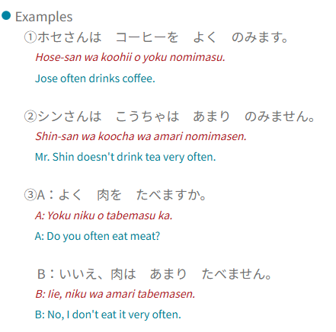

Slide 14


